Slide 1
State Space models and filtering
Daniel C

Slide 2
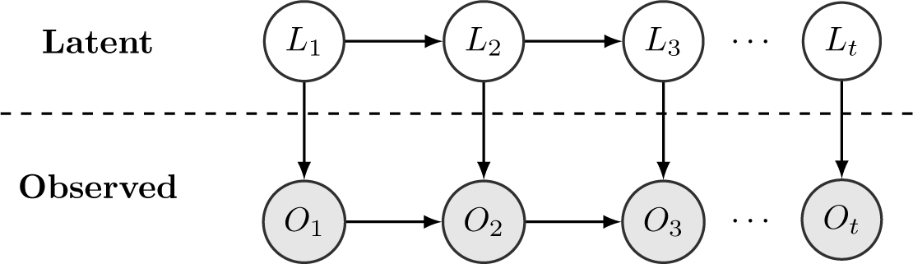
State space models

Slide 3
State space models
Sources of uncertainties:
Disturbances in predictive models
Noises of measurements

Slide 4
State space models
Filtering:
Estimating the current state based on observations
Balance different sources of uncertainties

Slide 5

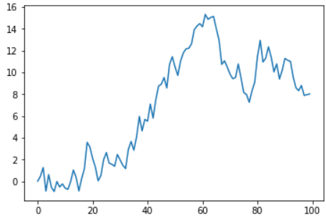
Example: Random walk

Slide 6

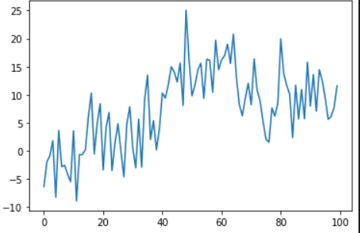
Example: Random walk

Slide 7
Example: Random walk
How can we deduce the first graph from the second graph as much as possible?
Previous estimation + Current observation
Which information do we trust more?

Slide 8
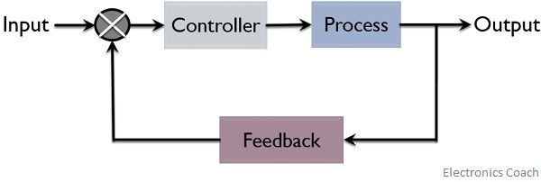
State estimation and control
Closed loop control

Slide 9
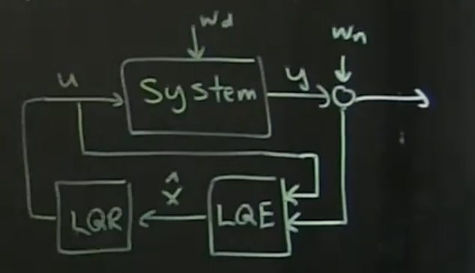
State estimation and control
Closed loop control with filtering

